Slide 1
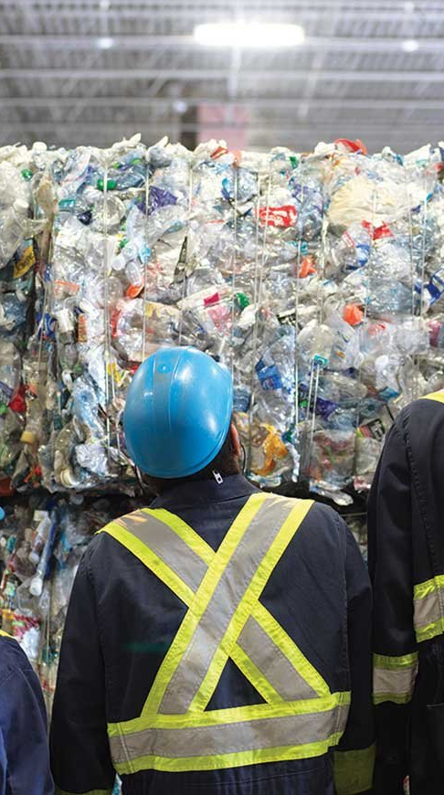
CEC SUMMIT
Your Trash Has a Business Plan
By Stacy Richardson – Founder/CEO Mobi Waste
A Titanic lesson about waste, value and the circular economy.
ASSETS • COMMODITIES • PRODUCTS • COLLABORATION • COMMUNITY
TRASH TALKING WITH STACY
01 / 13
Notes:
OPENING
Before we talk about trash, I want to talk about a ship.
The Titanic story deserves respect because it involved real human loss. I am using it for one specific lesson about systems: large systems can keep moving even after the danger becomes visible. Familiarity can feel safer than change. Outdated rules can look like readiness. Disconnected responses can waste the capacity we already have.
That lesson gives us a way to see the linear waste economy differently. This keynote is called “Your Trash Has a Business Plan” because the materials we discard still have physical, chemical and economic value. The question is whether we have designed a system capable of keeping that value in circulation.
IMAGE SOURCE: Alberta Depot, “Why Recycle Beverage Containers?” https://www.albertadepot.ca/why-recycle-beverage-containers
Illustrative photograph; it does not depict Mobi Waste operations.

Slide 2
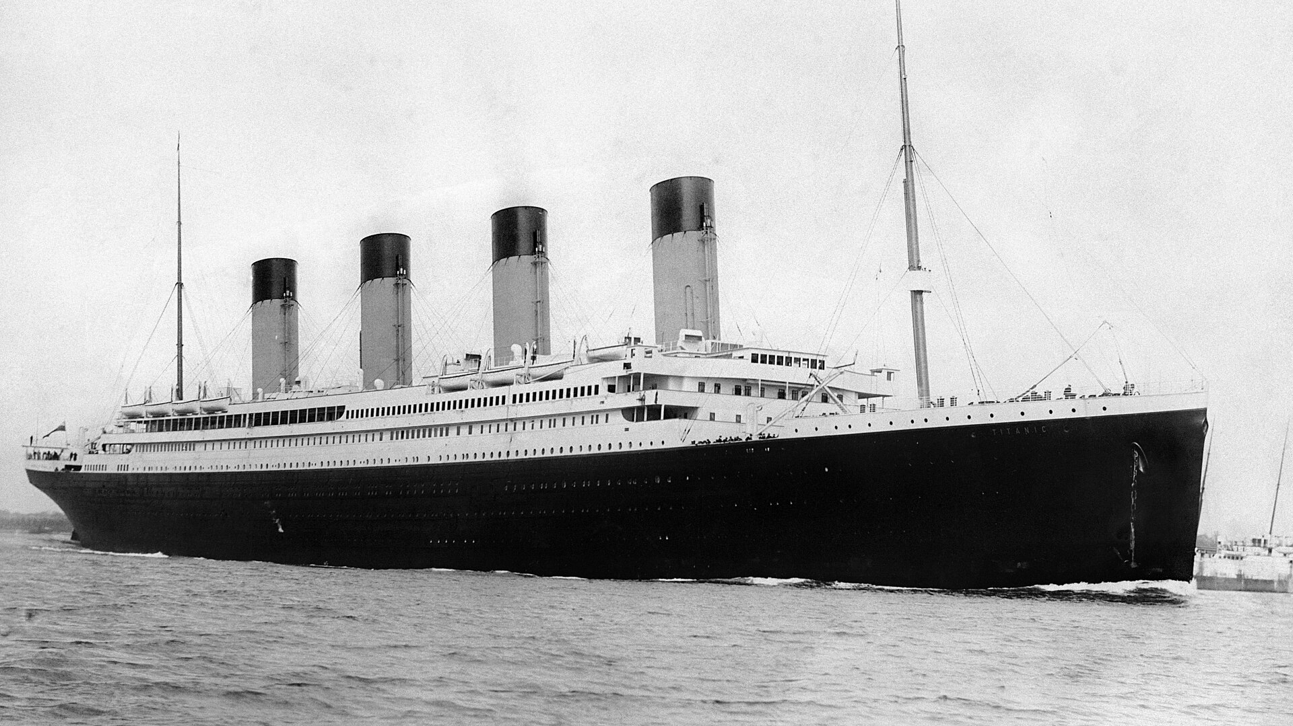
THE TITANIC LESSON
THE LIGHTS WERE STILL ON.
The music was still playing.
The ship still felt safer than the lifeboat.
So some passengers hesitated.
RMS TITANIC, APRIL 1912
TRASH TALKING WITH STACY
02 / 13
Notes:
THE SHIP WE REFUSE TO LEAVE
On the night of April 14, 1912, the Titanic struck an iceberg. The most important part of the story for us today is what happened before most people understood the danger.
The lights were still on. The music was still playing. The ship looked enormous, solid and safe. The lifeboats looked small, cold and uncertain. Some passengers hesitated because the familiar ship still felt safer than the unfamiliar way out.
That response was human. We often remain inside a system we know, even after the evidence tells us the system must change.
IMAGE SOURCE: Wikimedia Commons, “RMS Titanic 3.jpg,” archival photograph of Titanic departing Southampton. https://commons.wikimedia.org/wiki/File:RMS_Titanic_3.jpg

Slide 3
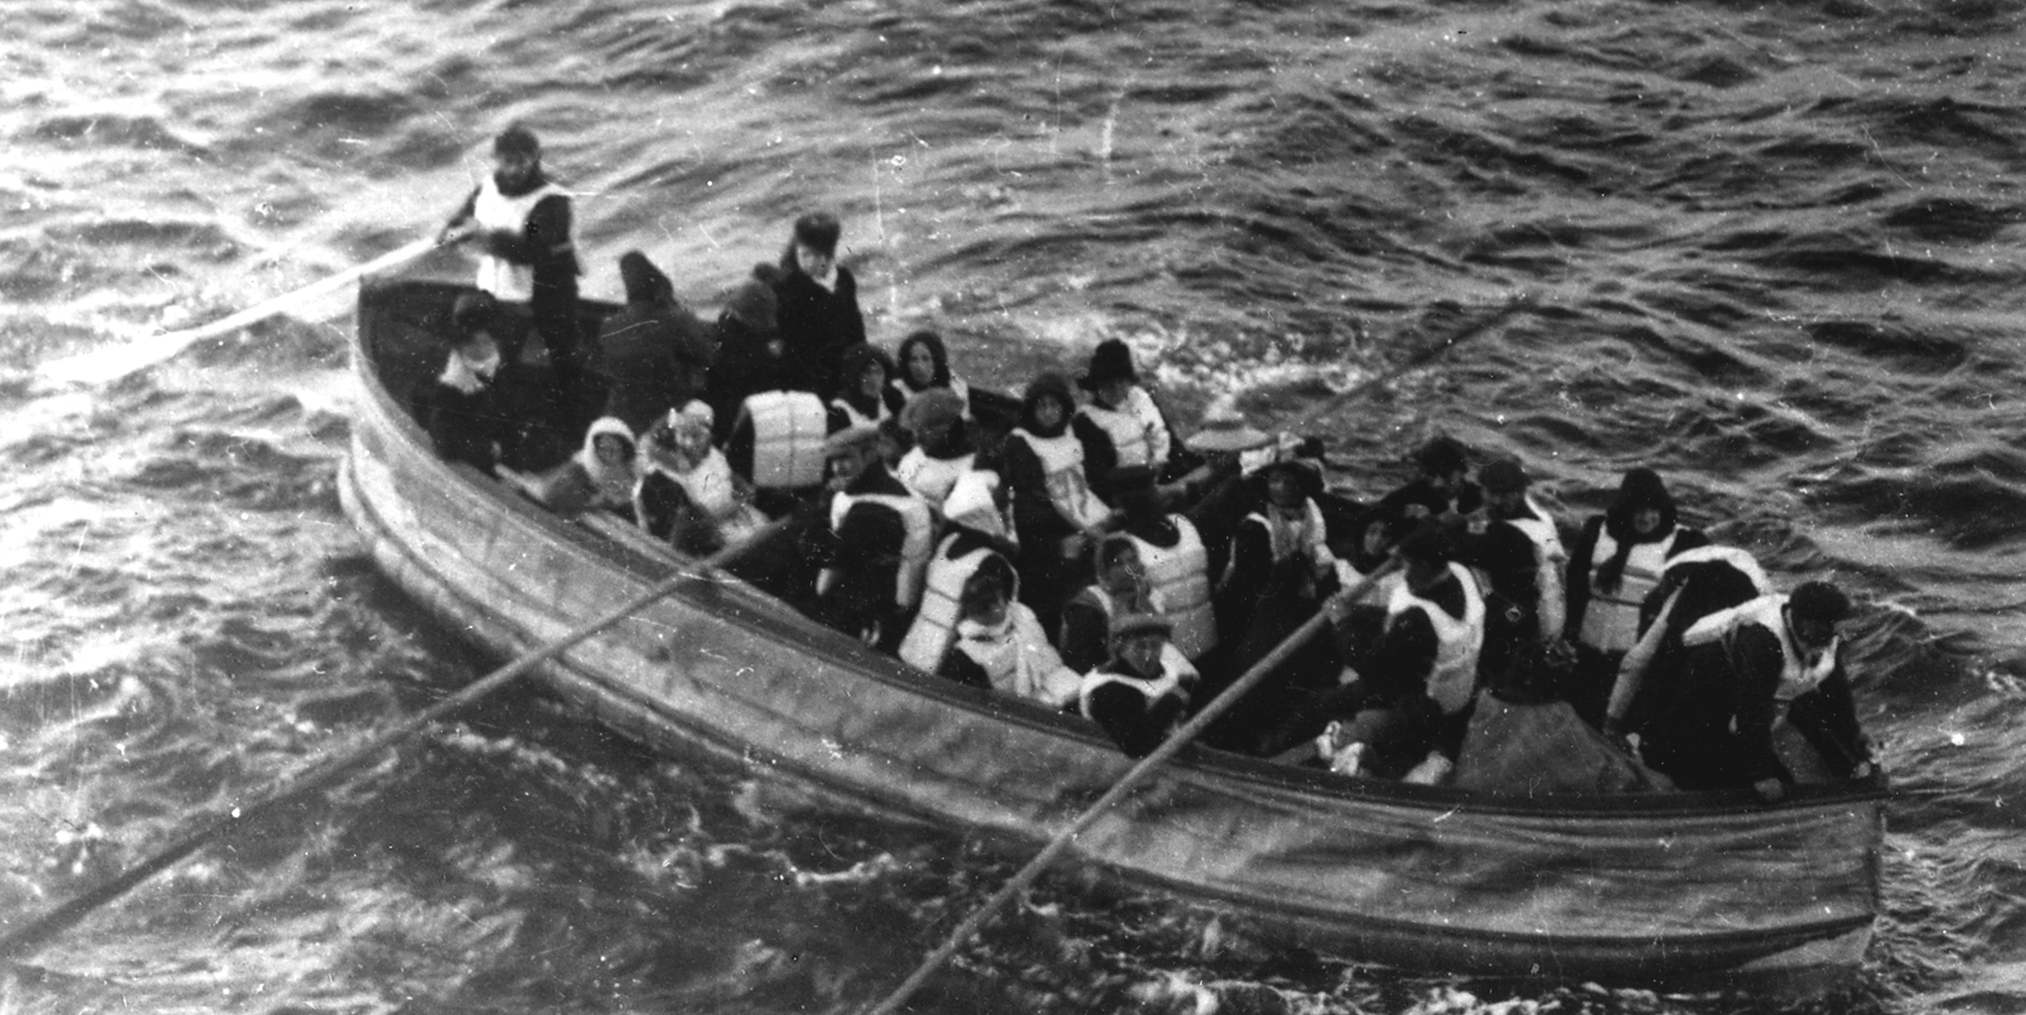
OUTDATED RULES
The rules said the ship was ready
20
LIFEBOATS
1,178
TOTAL LIFEBOAT CAPACITY
≈2,200
Some early boats left with empty seats. Existing capacity went unused.
PEOPLE ABOARD
COMPLIANCE DID NOT EQUAL PREPAREDNESS.
TRASH TALKING WITH STACY
03 / 13
Notes:
COMPLIANCE DID NOT EQUAL PREPAREDNESS
Titanic carried 20 lifeboats with capacity for 1,178 people, while approximately 2,200 people were aboard. The ship complied with the regulations of its era, but those rules had not kept pace with the size and capacity of modern ocean liners.
Then another failure appeared. Some early lifeboats left before they were full. The ship lacked enough capacity, and part of the capacity it did have went unused.
This gives us two lessons. Compliance does not guarantee readiness. Capacity only helps when a system knows how to use it.
SOURCES: Encyclopaedia Britannica, “Titanic.” https://www.britannica.com/topic/Titanic
American Historical Association, “Titanic: Did the Maker of True Lies Tell the Truth about History?” https://www.historians.org/perspectives-article/titanic-did-the-maker-of-true-lies-tell-the-truth-about-history-march-1998/
IMAGE SOURCE: Wikimedia Commons, “Titanic-lifeboat.gif,” photograph attributed to J. W. Barker from RMS Carpathia. https://commons.wikimedia.org/wiki/File:Titanic-lifeboat.gif
The image documents Titanic survivors in a lifeboat. It does not depict one of the early underfilled launches.

Slide 4
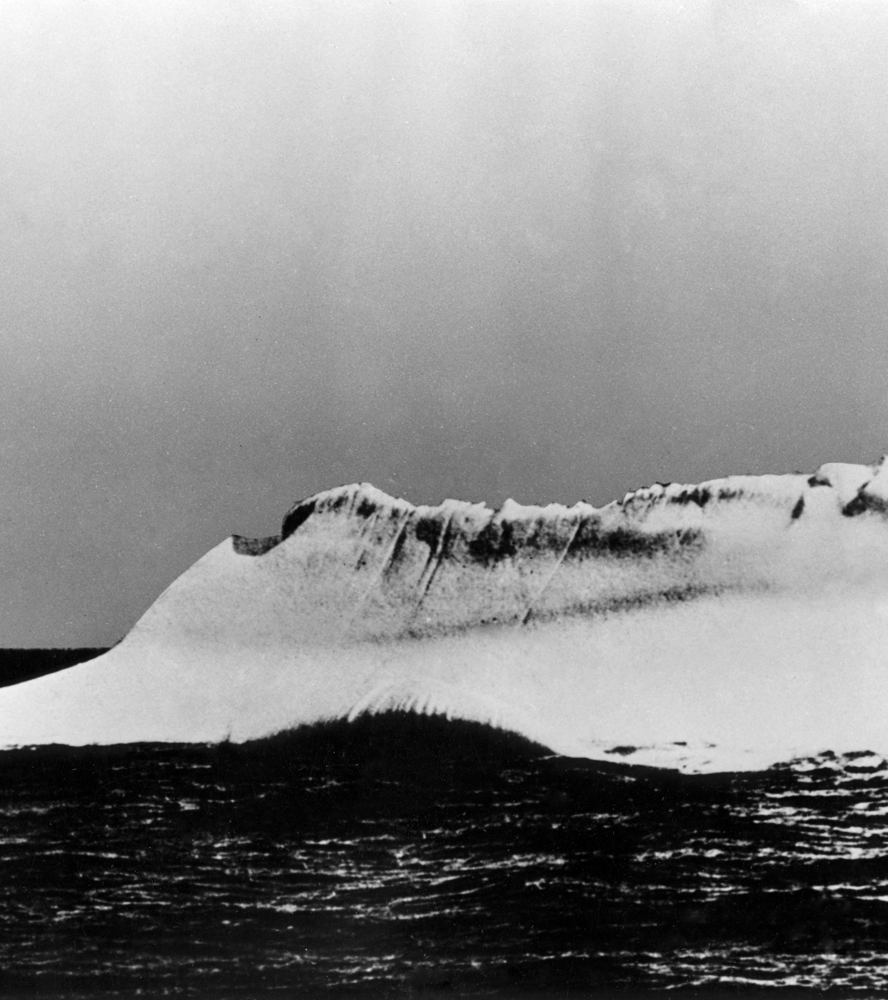
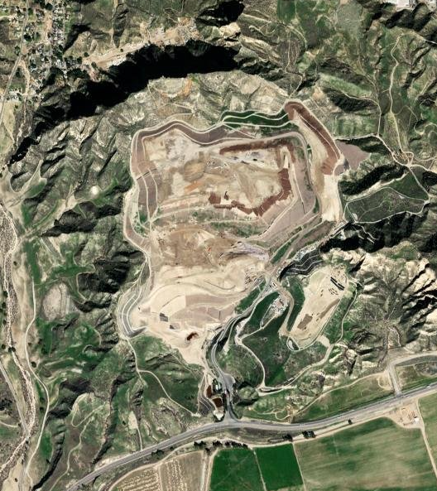
THE ICEBERG
THE LINEAR ECONOMY
The danger became visible before everyone accepted what it meant.
Finite disposal space, lost material value and environmental risk are already visible.
WE ARE STILL ABOARD A SYSTEM BUILT TO BURY VALUE.
The problem is dependence on disposal as the default destination.
We have lost 80% of our landfills since 1980.
TRASH TALKING WITH STACY
04 / 13
Notes:
THE WASTE CONNECTION
Today, we are standing on another enormous system: the linear economy. It tells us to extract, manufacture, buy, use and throw away.
For a long time, that system appeared to work. Products moved. Businesses grew. Trash disappeared from the curb. But now the warning signs are visible. Landfill space is finite. New disposal capacity is difficult and expensive to site. Valuable materials are buried. Poorly managed waste can contaminate soil and water, while even engineered systems require long-term environmental controls.
The point is not that every landfill equals a disaster. The point is that an economy built around disposal keeps sacrificing material value and depending on a finite destination.
ICEBERG IMAGE SOURCE: The History Blog, photograph by Captain William De Carteret near the Titanic wreck site during the Minia recovery voyage. https://www.thehistoryblog.com/archives/38959
This is one of several proposed candidates and is not confirmed as the iceberg Titanic struck.
LANDFILL IMAGE SOURCE: U.S. Environmental Protection Agency, Chiquita Canyon Landfill aerial photograph. https://www.epa.gov/ca/chiquita-canyon-landfill
The landfill image is illustrative of disposal infrastructure and does not represent every landfill's operating conditions.

Slide 5
THE LINEAR MODEL
The product had a plan. The material did not.
1
2
3
4
5
MAKE
BUY + USE
DISCARD + MIX
COLLECT + HAUL
BURY + LOSE
→
→
→
→
Raw materials +
energy enter
Product value is
recognized
Identity, quality +
recoverability decline
Pay to move volume;
costs rise
No next user; value
leaves the economy
WHAT IS MISSING?
NEXT USER • USABLE SPECIFICATION • PROCESSOR • BUYER • RETURN PATH
Mixing material does not erase its value. It makes that value harder and more expensive to recover.
The product had a business plan. The trash got a disposal contract.
TRASH TALKING WITH STACY
05 / 13
Notes:
THE LINEAR MODEL
This is the business plan of a linear economy. We extract and make. We buy and use. Then we discard and mix materials together. Once mixed, their identity, quality and recoverability begin to decline. We pay to collect and haul volume, contamination and trapped air. Finally, we bury what remains and allow the value to leave the economy.
The material did not suddenly become worthless. The system lost the next user.
For a material to become circular, it needs a planned next user, a usable specification, a processor, a buyer and a route back into production. Without those pieces, the product had a business plan, but the trash got a disposal contract.
That is why circularity is not simply a better bin. It is a different value chain.

Slide 6
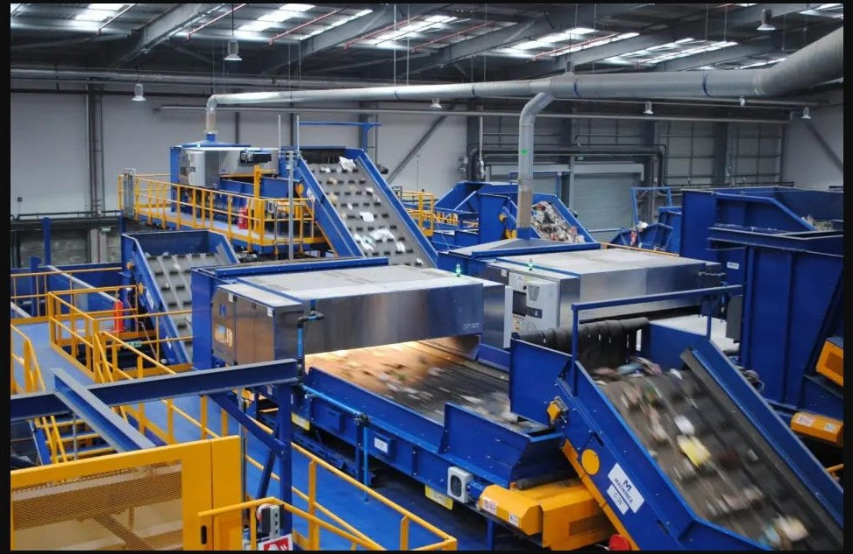
RECOVERY CAPACITY
A SuperMRF turns mixed flow into qualified feedstock
MIXED FLOW IN
QUALIFIED OUTPUT
High volume
Many material categories
Contamination + trapped air
Fragmented hauling
Separate more streams
Clean + condition material
Grade to buyer specifications
Measure commodities + residuals
A SuperMRF prepares material for processors and manufacturers. It does not complete the circle by itself.
The facility prepares the material. Processors, manufacturers and buyers complete the circle.
TRASH TALKING WITH STACY
06 / 13
Notes:
SUPERM RF RECOVERY CAPACITY
A SuperMRF is one idea for building recovery capacity at regional scale. It receives high volumes of mixed material, separates more categories than a traditional materials recovery facility, cleans and conditions those outputs, qualifies them to buyer specifications and supplies processors with more consistent feedstock.
That last point matters. Small green technology companies cannot scale if their input arrives unpredictably, with changing quality and changing chemistry.
The SuperMRF is not the circular economy by itself. It prepares the material. Processors, manufacturers and buyers complete the circle. Residuals still remain, and a credible system measures them honestly rather than hiding them behind a zero-waste claim.
IMAGE SOURCE: Machinex Sorting, single-stream materials recovery system photograph. https://www.machinexrecycling.com/wp-content/uploads/2023/03/single_stream-013017-1-2.jpg
Source page: https://www.machinexrecycling.com/sorting/case-studies/
The photograph is used as an illustrative example of automated recovery infrastructure. Vendor branding is not displayed on the slide.

Slide 7
FROM SILOS TO SYSTEMS
The circular economy is an operating model
MATERIAL
OWNERS
HAULERS
RECOVERY
TECHNOLOGY
+ CAPITAL
//
//
//
inconsistent supply
excess miles
contamination
duplicated investment
↓
ONE CONNECTED SYSTEM
shared feedstock • shorter routes • cleaner specifications • shared infrastructure • verified buyers
VALUE MODEL: processing + tipping • commodity sales • avoided disposal + hauling • shared savings
CONSISTENT FEEDSTOCK • LOWER CAPITAL BURDEN
MORE VALUE KEPT IN CIRCULATION
PUBLIC + PRIVATE PARTNERSHIP
SHARED SITE • SHARED DATA • SHARED ACCOUNTABILITY
Bring the companies to the material. Give every recovered asset a next user.
TRASH TALKING WITH STACY
09 / 13
Notes:
FROM SILOS TO SYSTEMS
This is the central shift. Today, material owners, haulers, recovery facilities, processors, technology companies, buyers and capital providers often make decisions in separate silos.
That fragmentation creates inconsistent feedstock, unnecessary hauling, contamination, duplicated infrastructure and projects without a committed buyer.
A connected system aligns them around the same material pathway. It combines reliable supply, shorter routes, shared infrastructure, compatible specifications, data and offtake relationships.
The economics can come from several sources: processing or tipping fees, commodity sales, avoided disposal and hauling, shared infrastructure savings and verified environmental value. Those revenue and savings streams must be tested honestly for each project.
The ownership model could be public-private, a special-purpose entity or another partnership structure. The precise legal form matters less than the operating principle: shared site, shared data, shared accountability and a verified next user.
Bring the companies to the material. Give every recovered asset a next user.

Slide 8
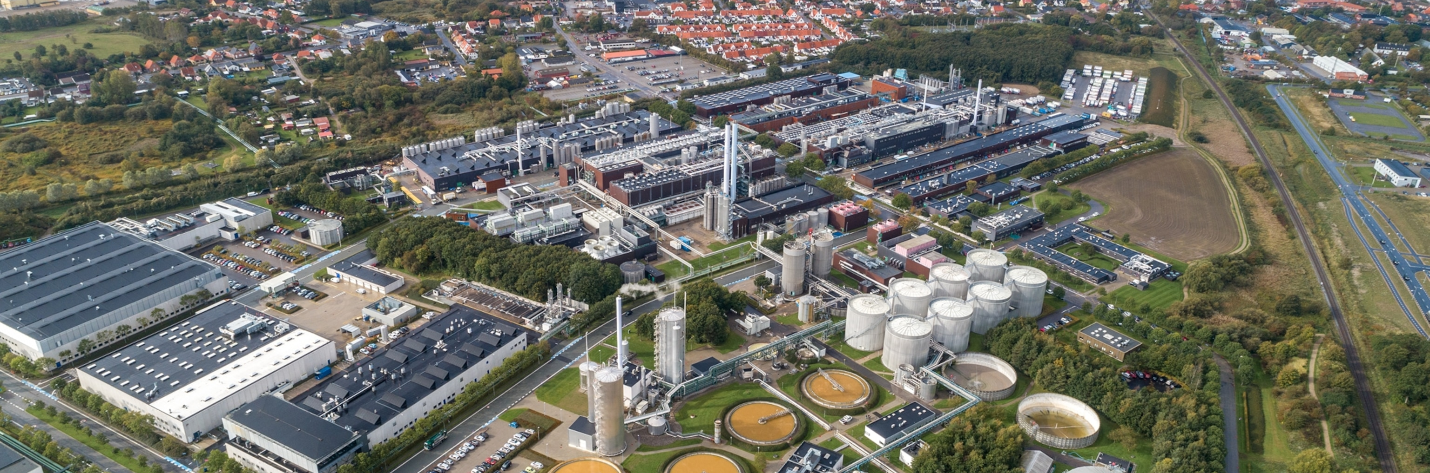
THE GREEN INDUSTRIAL HUB
Three conditions let green technology company’s scale
1
CONSISTENT FEEDSTOCK
2
LOWER HAULING COST
3
SHARED INFRASTRUCTURE
Reliable volume, quality
and long-term supply
Bring companies to material;
stop moving low-value volume
Cut operating costs and
required investment dollars
GREEN INDUSTRIAL HUB
SuperMRF → qualified feedstock → on-site processors → commodities → new products
SHARED: utilities • storage • preprocessing • equipment • logistics • data • workforce
KALUNDBORG, DENMARK • INDUSTRIAL SYMBIOSIS IN PRACTICE
Green technology cannot scale on inconsistent material, expensive transportation and duplicated infrastructure.
TRASH TALKING WITH STACY
08 / 13
Notes:
THREE KEYS TO SCALING GREEN TECHNOLOGY
Small green technology companies repeatedly face three barriers.
First, they need consistent feedstock — dependable volume, dependable quality and a long enough supply commitment to finance equipment and operations.
Second, hauling costs are growing. Every unnecessary mile can consume the value we are trying to recover. A hub brings companies to the material instead of endlessly moving low-value volume to scattered destinations.
Third, shared infrastructure cuts both operating costs and required investment dollars. Utilities, storage, preprocessing, equipment, logistics, data systems and workforce capacity do not need to be duplicated by every tenant.
The green industrial hub addresses all three. The SuperMRF prepares material. On-site or nearby companies transform that feedstock into commodities and products. Shared systems lower the barriers that each company would face alone.
IMAGE SOURCE: National Geographic, “Here’s how a ‘circular economy’ could save the world.” https://www.nationalgeographic.com/magazine/article/how-a-circular-economy-could-save-the-world-feature/
The photograph shows Kalundborg, Denmark; it is a real-world industrial symbiosis example, not a proposed Mobi Waste site.

Slide 9
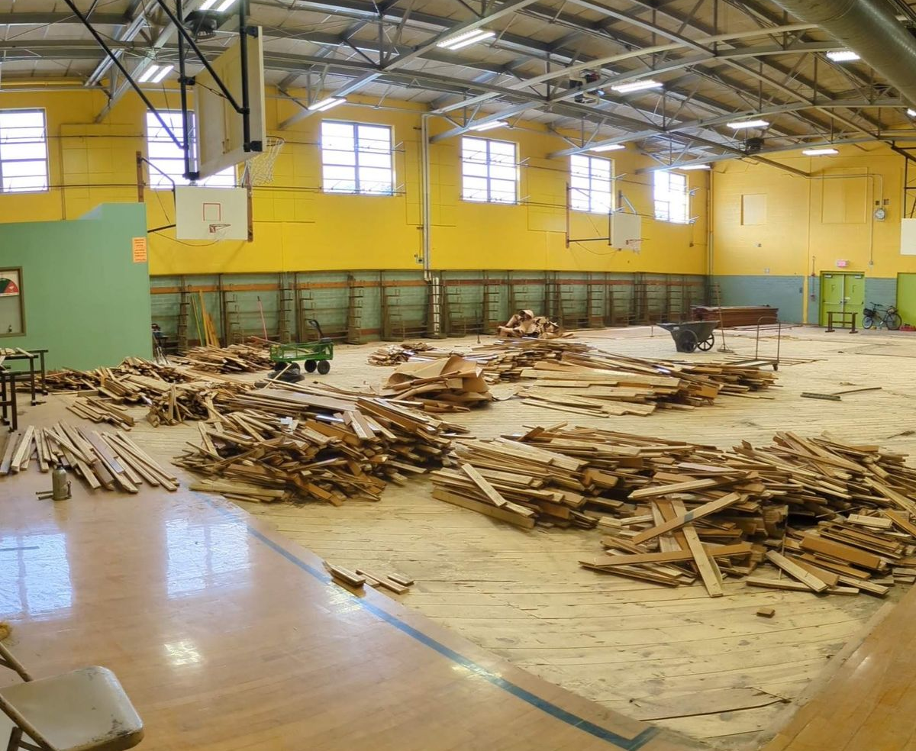
AUSTIN ISD
Austin ISD pairs a goal with a working system
ZERO WASTE GOAL: 90% LESS LANDFILL BY 2040
OPERATIONS
Lunchroom recycling + composting
27M+ pounds diverted since Jan. 2022 • waste data by campus
RECOVERY
Reusable service ware where possible
Surplus sales extend product life • proceeds support students + schools
LEARNING
Green teams + waste audits • solar as a living lab
Paid internships + sustainability career pathways
MATERIAL SALVAGE AT AN AUSTIN ISD FACILITY
Existing work creates the foundation. The next opportunity is to connect more material to verified local users.
A circular system can begin anywhere an institution controls purchasing, operations and where it goes next.
TRASH TALKING WITH STACY
11 / 13
Notes:
AUSTIN ISD: START WHERE THE HANDOFFS ARE CONTROLLABLE
Austin ISD shows the difference between an aspiration and an operating system. The district has a zero-waste goal, and it also has daily practices that move material toward that goal.
Every school has lunchroom recycling and composting. Since January 2022, the district reports more than 27 million pounds diverted. The district extends product life through surplus sales, uses waste data for learning, operates solar arrays at 14 campuses and connects students with paid internships and sustainability career pathways.
Those are existing actions. The future opportunity is to connect more of the district's recurring material streams to verified processors and buyers, then use its purchasing power to help close the loop.
A school district is a powerful starting point because it controls purchasing, operations, routes, education and many handoffs across multiple campuses. A circular system can begin anywhere an institution controls the handoffs.
Sources: Austin ISD Zero Waste. https://www.austinisd.org/sustainability/zero-waste
Austin ISD Solar & Renewable Energy. https://www.austinisd.org/sustainability/energyandwater/solar-and-renewable-energy
Austin ISD Student Career Pathways. https://www.austinisd.org/sustainability/get-involved/student-career-pathways
IMAGE SOURCE: CultureMap Austin, “Austin sawmill saves and sells wood from old AISD building.” https://austin.culturemap.com/news/city-life/harvest-lumber-co-aisd-recovery/

Slide 10
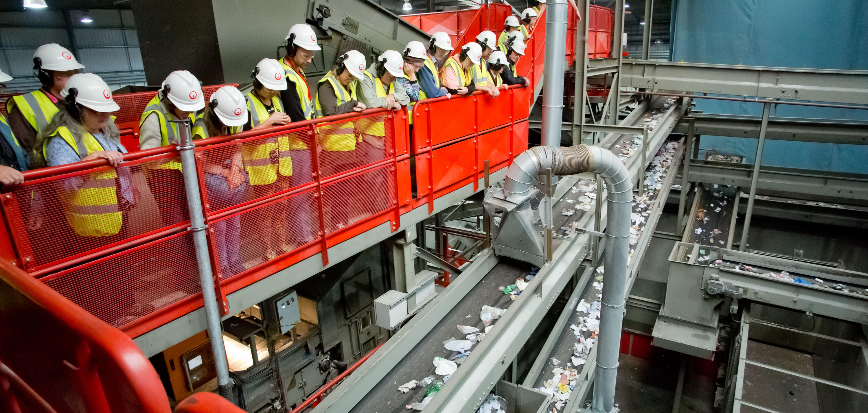
THE COLLECTIVE
Each panelist holds one part of the circular system
MyCo
Fungi + nutrients
Baylor College of Medicine
Biological PET
THE SHARED HUB
FEEDSTOCK
DATA + CONTRACTS
BIOLOGY + MATERIALS
HYDROGEN + CARBON
INFRASTRUCTURE + CAPITAL
Flash Hydrogen
Hydrogen + carbon
ILLUSTRATIVE FACILITY COLLABORATION
MAXARI
Integration + delivery
Dr. D. Marshall Porterfield • Dr. Felipe-Andrés Piedra • Vladimir Mancevski • Lisa Prusak, MA, SHRM-SCP
Each holds one part. Collaboration completes the circle.
TRASH TALKING WITH STACY
12 / 13
Notes:
THE PANEL AS THE COLLECTIVE
The keynote has now touched each part of the panel's circular pathway.
Dr. D. Marshall Porterfield brings fungal biomanufacturing and controlled nutrient flows. Dr. Felipe-Andrés Piedra brings biological PET conversion. Vladimir Mancevski brings hydrogen and advanced carbon pathways for plastics. Maxari Energy Solutions brings the integration, energy, infrastructure, finance and project delivery needed to build.
Each panelist holds one part. The opportunity is to connect them through a shared site, reliable feedstock, compatible specifications, data, contracts and buyers. Collaboration completes the circle.
Suggested opening panel question: Each of you represents one part of the pathway. If you were given one shared site, a reliable feedstock agreement and three years, what would you build together — and what evidence would prove the material truly stayed in circulation?
Sources: Purdue University mycoponics research. https://ag.purdue.edu/news/2026/08/mushrooms-in-space-purdue-researchers-invent-mycoponics-to-cultivate-fungi-for-earth-the-moon-and-beyond.html
Baylor College of Medicine, Felipe-Andrés Piedra and RestoreLAB. https://www.bcm.edu/people-search/felipe-andres-piedra-28713
Rice University, waste plastic to hydrogen and graphene research. https://news.rice.edu/news/2023/making-hydrogen-waste-plastic-could-pay-itself
Maxari Energy Solutions. https://energy.maxari.us/about-us
IMAGE SOURCE: Veolia UK, facility-tour photograph accompanying “Veolia wins new contract with Medway Council.” https://www.veolia.co.uk/press-releases/veolia-wins-new-contract-medway-council
Illustrative collaboration image; the people shown are not the CEC panelists.

Slide 11
CHANGE COURSE TOGETHER
WE STILL HAVE TIME.
SEEING THE DANGER IS NOT ENOUGH. • A FEW LIFEBOATS ARE NOT ENOUGH. • YESTERDAY'S RULES ARE NOT ENOUGH.
THE SYSTEM DETERMINES WHETHER ITS VALUE IS KEPT OR LOST.
We do not need more lifeboats. We need to change course.
And let’s do it TOGETHER!
The circular economy begins when we connect everything together.
TRASH TALKING WITH STACY
13 / 13
Notes:
CLOSING AND PANEL TRANSITION
The Titanic teaches us that seeing the danger is not enough. Having a few lifeboats is not enough. Following yesterday's rules is not enough.
We need the capacity, connections and courage to change direction while we still have time.
What we call waste is the cargo we keep throwing overboard. It still contains material, energy and economic value. Those materials are assets waiting for a connected system capable of recovering them.
But circularity should never become an excuse to generate more waste. The order matters: generate less, reuse what we can, and then recover the remainder at its highest practical value.
The practical path is to measure the material, identify recoverable streams, confirm processors and buyers, form the collective, pilot verified handoffs and then build the shared infrastructure.
So here is the invitation. Bring one material stream, one processing capability, one purchasing commitment, one site, one source of capital or one workforce solution.
The circular economy begins when we connect them.

