Slide 1
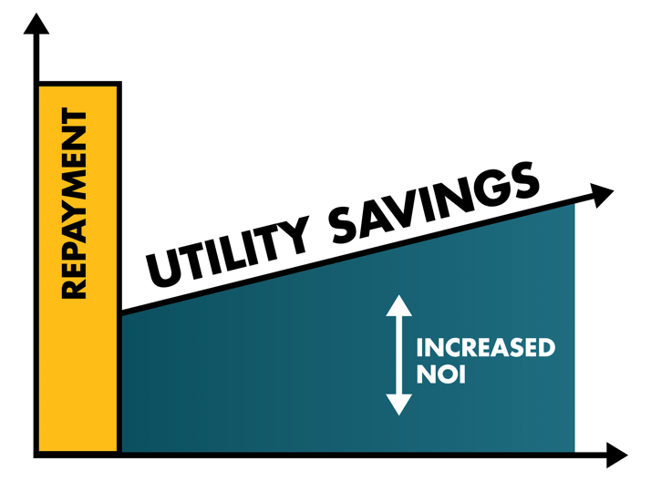
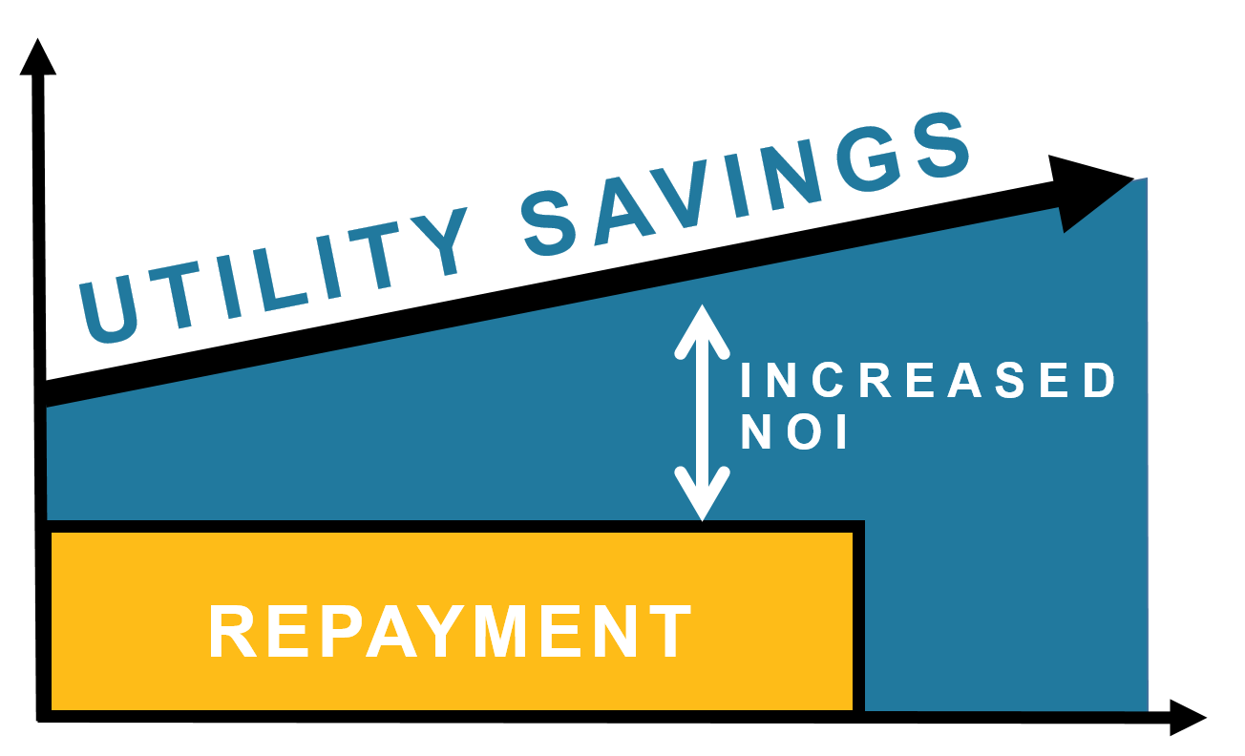

PROPERTY OWNER BENEFITS
Pay for today’s upgrades with tomorrow’s savings
Improves assets - budget neutral/cashflow positive
Equipment Financing
PACE
$
$
TIME
TIME
© 2026 Texas PACE Authority | James Cargas Presenting
Notes:
Slides from James Cargas, Texas PACE Authority
Cell: (703) 472-0359
James@TexasPACEAuthority.org

Slide 2








Municipalities & Counties
501(c)(3)
Governmental
Private
Capital Providers
Property Owners
Service Providers
© 2026 Texas PACE Authority | James Cargas Presenting

Slide 3
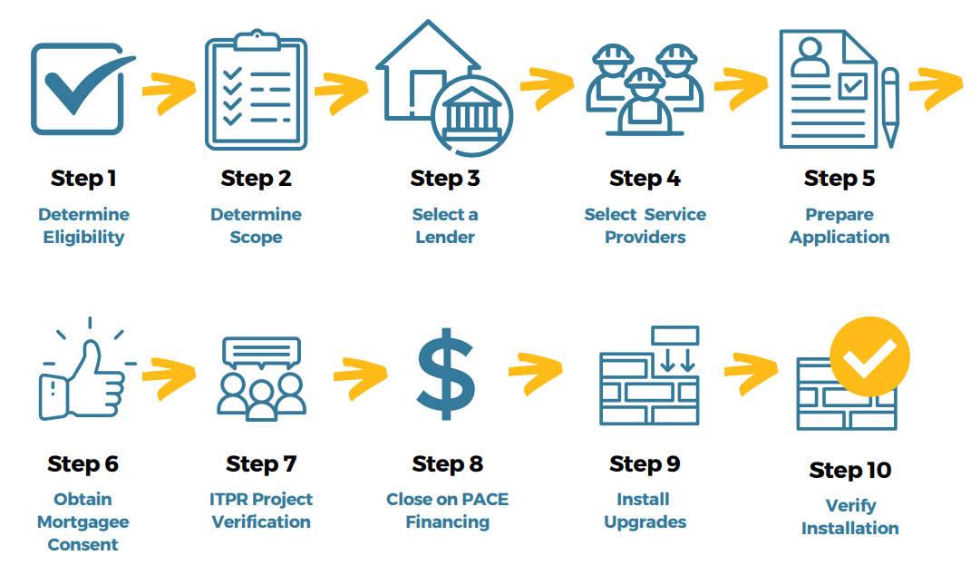
PACE PROJECT DEVELOPMENT PROCESS www.texaspaceauthority.org/quick-start-guide
Phase 1
Pre-Application
Feasibility
Phase 2
Post-Application
Execution
© 2026 Texas PACE Authority | James Cargas Presenting

Slide 4
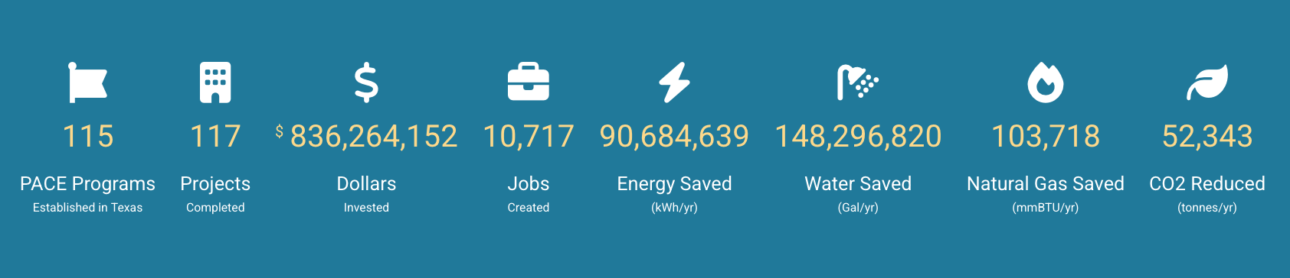
PACE Projects Impacts in Texas
BONUS SLIDE
www.texaspaceauthority.org/project-list/
© 2026 Texas PACE Authority | James Cargas Presenting

