Slide 1
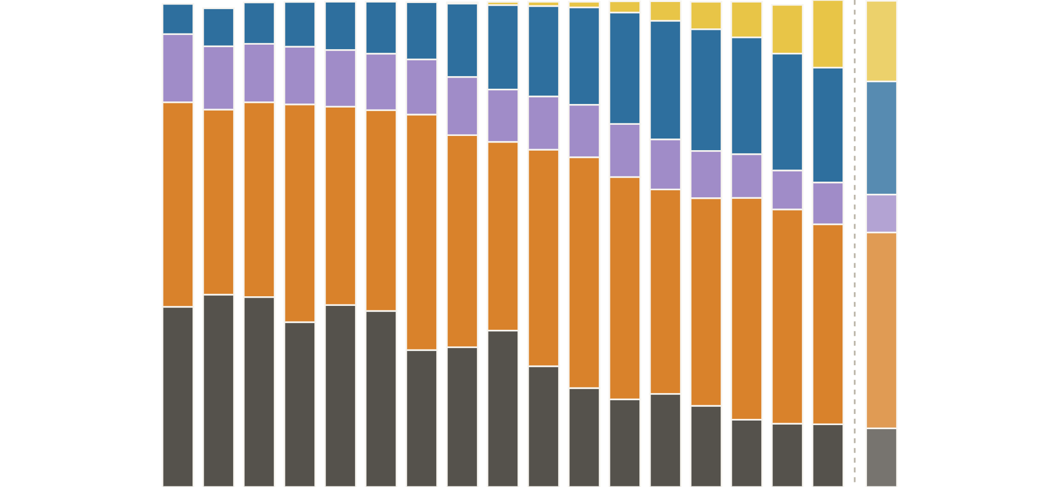
Wind and solar have displaced coal
ERCOT · SUPPLY MIX
Share of ERCOT electricity generation by fuel, 2009–2026 (2026 through Oct 14)
Wind 6%
Solar 17%
6% → 40%
Nuclear 14%
Wind plus solar share
Wind 23%
Gas 42%
Nuclear 8%
37% → 12%
Coal’s share
Gas 40%
Coal 37%
Coal 12%
’09
’10
’11
’12
’13
’14
’15
’16
’17
’18
’19
’20
’21
’22
’23
’24
’25
’26
YTD
Sources: ERCOT reports (2009–11, 2024–25); Texas Comptroller (2012–23); EIA grid data (2026, Jan 1–Oct 14)
Notes:
Natural gas has supplied roughly 38–48% of ERCOT’s generation every year since 2009 and remains the backbone of the grid. The big shift is underneath it: coal fell from about 37% of generation in 2009 (and nearly 40% in 2010–11) to about 12% so far in 2026, while wind grew from 6% to about 23% and solar went from essentially zero to about 17%. Solar passed coal in 2025 and is well ahead of it in 2026. Nuclear’s share slipped from about 14% to 8% only because total demand grew; its output has stayed roughly flat. 2026 so far (Jan 1–Oct 14, EIA hourly operator data, about 416 TWh): gas 40%, wind 23%, solar 17%, coal 12%, nuclear 8%. It is a partial year, so it over-weights spring wind and summer solar relative to a full year, and it is shown slightly faded beside the dashed line. Capacity tells where this is heading. ERCOT’s summer 2026 installed capacity is about 37.5% gas, 22.4% wind, 19.7% solar, 8.6% battery storage, 7.6% coal and 2.9% nuclear, so batteries now outweigh coal in installed capacity. Data note: 2009–11 shares are ERCOT’s published energy-by-fuel figures (2009 annual report, 2010 as reported by the Texas Tribune, 2011 quick facts); 2012–23 are computed from ERCOT generation by fuel compiled by the Texas Comptroller; 2024 and 2025 are ERCOT’s published energy-use mix (rounded for 2024); 2026 is summed from EIA daily data. Sources differ slightly in method, by a point or so. Small “other” sources are under 2% and not shown.

Slide 2
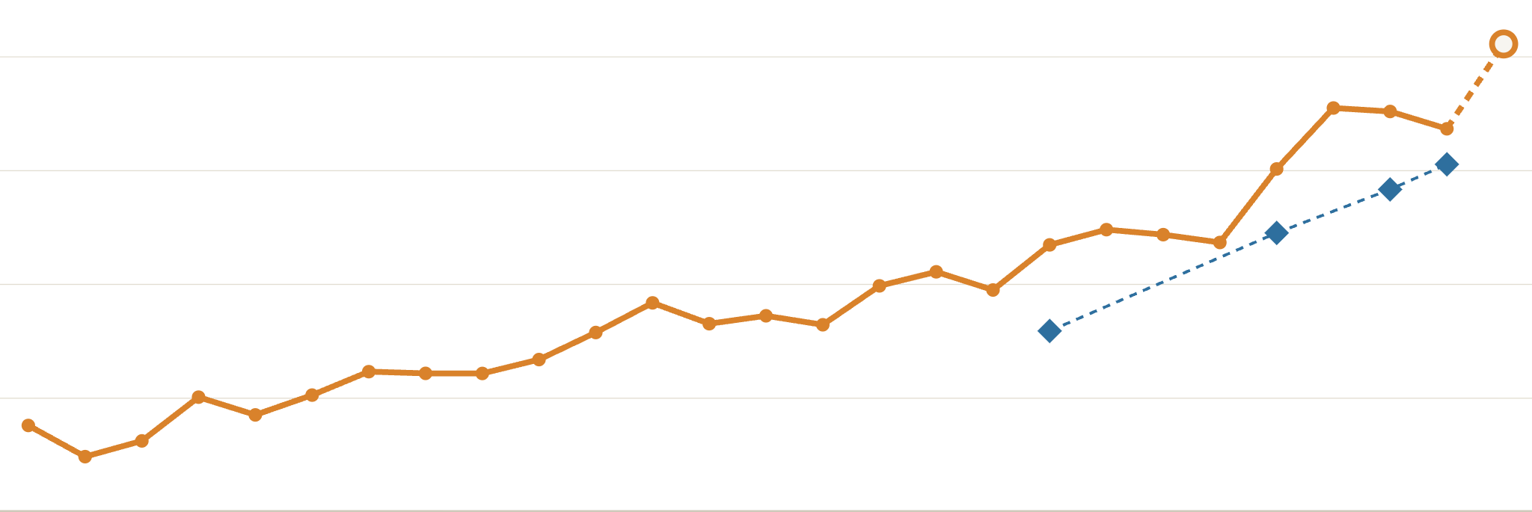
Peak demand is up 58% since 2000
ERCOT · PEAK DEMAND
● Yearly peak
◆ Winter record peaks
GW
91.1
90
85.5
80
80.6
70
65.9
60
57.6
50
’00
’01
’02
’03
’04
’05
’06
’07
’08
’09
’10
’11
’12
’13
’14
’15
’16
’17
’18
’19
’20
’21
’22
’23
’24
’25
’26
Sources: ERCOT yearly peak-demand records, monthly reports and Oct 2026 fact sheet. 2026 peak is preliminary.
Notes:
ERCOT’s yearly peak has climbed from about 57.6 GW in 2000 to roughly 91.1 GW on July 22, 2026, a preliminary figure until final settlement. Growth was slow for two decades, then jumped after 2021: 80.1 GW in 2022 and 85.5 GW in 2023, a record that held through a mild summer 2025 before it fell in 2026. Every year’s peak since 2000 came in summer. But winter peaks are rising faster: the winter record went from 65.9 GW in January 2018 to 74.5 GW in Winter Storm Elliott (December 2022), 78.3 GW in January 2024 and 80.6 GW in February 2025. ERCOT estimates January 2026’s Winter Storm Fern would have peaked near 84.6 GW without demand reductions from large customers; actual demand came in lower. Winter peaks are shown only where a new record was set, since ERCOT does not publish a consistent yearly winter-peak series. The peak-demand axis starts at 50 GW.

Slide 3
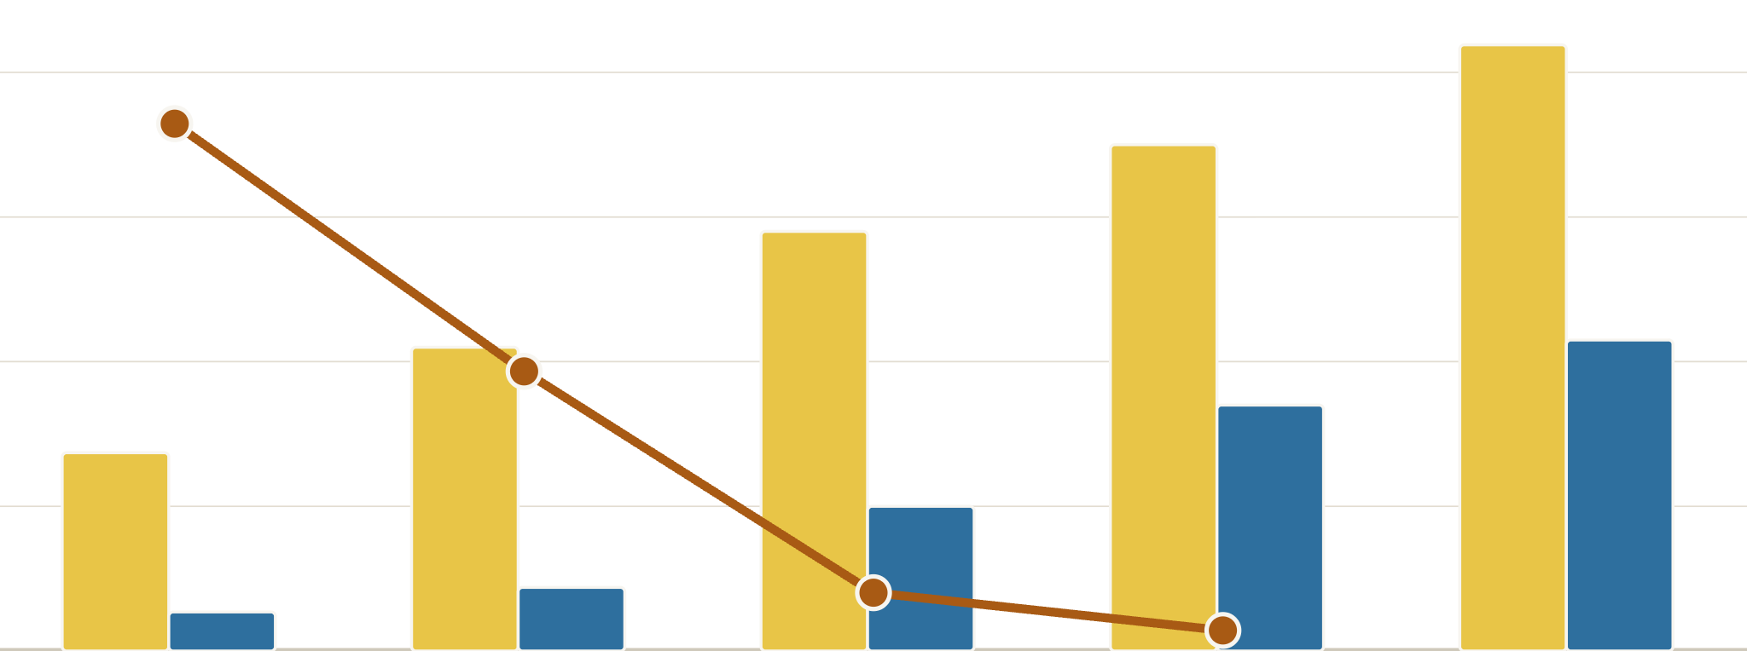
Solar and batteries avert close calls
ERCOT · RELIABILITY
Solar and battery capacity vs. hours when ERCOT’s scarcity pricing kicked in, 2022–2026
■ Solar capacity, GW
■ Battery capacity, GW
● Scarcity-pricing hours (right axis)
GW
42
hours
40
1,600
35
30
29
1,200
21
22
20
17
800
14
10
10
400
3
4
0
0
2022
2023
2024
2025
2026
Scarcity-pricing hours
1,458
773
161
57
Not yet out
Days asked to conserve
2
11
2
0
0
Capacity at year end (2026 as of Oct.; 2025 solar estimated). Sources: Potomac Economics; ERCOT; Texas 2036
Notes:
Bars show installed solar and battery capacity (left axis, GW); the line shows hours each year when ERCOT’s scarcity pricing (the operating reserve demand curve adder) was active, a market signal that reserves were getting thin (right axis). As solar went from about 14 GW to 42 GW and batteries from under 3 GW to over 21 GW, scarcity hours fell from 1,458 in 2022 to 57 in 2025. The market monitor attributes most of the gain in available reserves to solar and storage. This measure is largely insulated from gas prices: gas was cheaper in 2024 than 2025, yet scarcity hours kept falling. The bottom row counts days ERCOT asked the public to conserve: 11 in the record-heat summer of 2023, two in January 2024 during a cold snap, and none in 2025 or 2026, even through Winter Storm Fern and the 91.1 GW record peak on July 22, 2026. That day real-time prices topped out near $378/MWh while batteries discharged a record 11,980 MW; on Aug. 20, 2024, prices hit the $5,000 cap. In summer 2024, the Dallas Fed found evening (6–9 p.m.) prices averaged about $80/MWh versus $332 in 2023. 2021 is left out: its 612 scarcity hours and 11 conservation days were dominated by Winter Storm Uri, a gas and freeze failure rather than a summer supply-margin story. Data notes: scarcity hours are from Potomac Economics (2025 State of the Market); the 2026 figure will come in its 2026 report, due mid-2027. Capacity is at year end from Potomac Economics reports for 2022–2024 (2023 solar “over 20 GW,” about 21 GW) and battery capacity for 2025 (more than 17 GW). 2025 solar (~35 GW) is estimated between ERCOT’s July 2025 (32.7 GW) and October 2026 (41.9 GW) fact sheets. 2026 is ERCOT’s October 2026 fact sheet. Conservation days through January 2024 are from ERCOT’s list; later years from ERCOT event reports, the Dallas Fed and Texas 2036.

