Slide 1
Greater Houston Environmental Summit
Resilient by Design: Energy, Infrastructure, and Climate Readiness for the Gulf Coast
Ana Baskharone
October 23, 2026

Slide 2
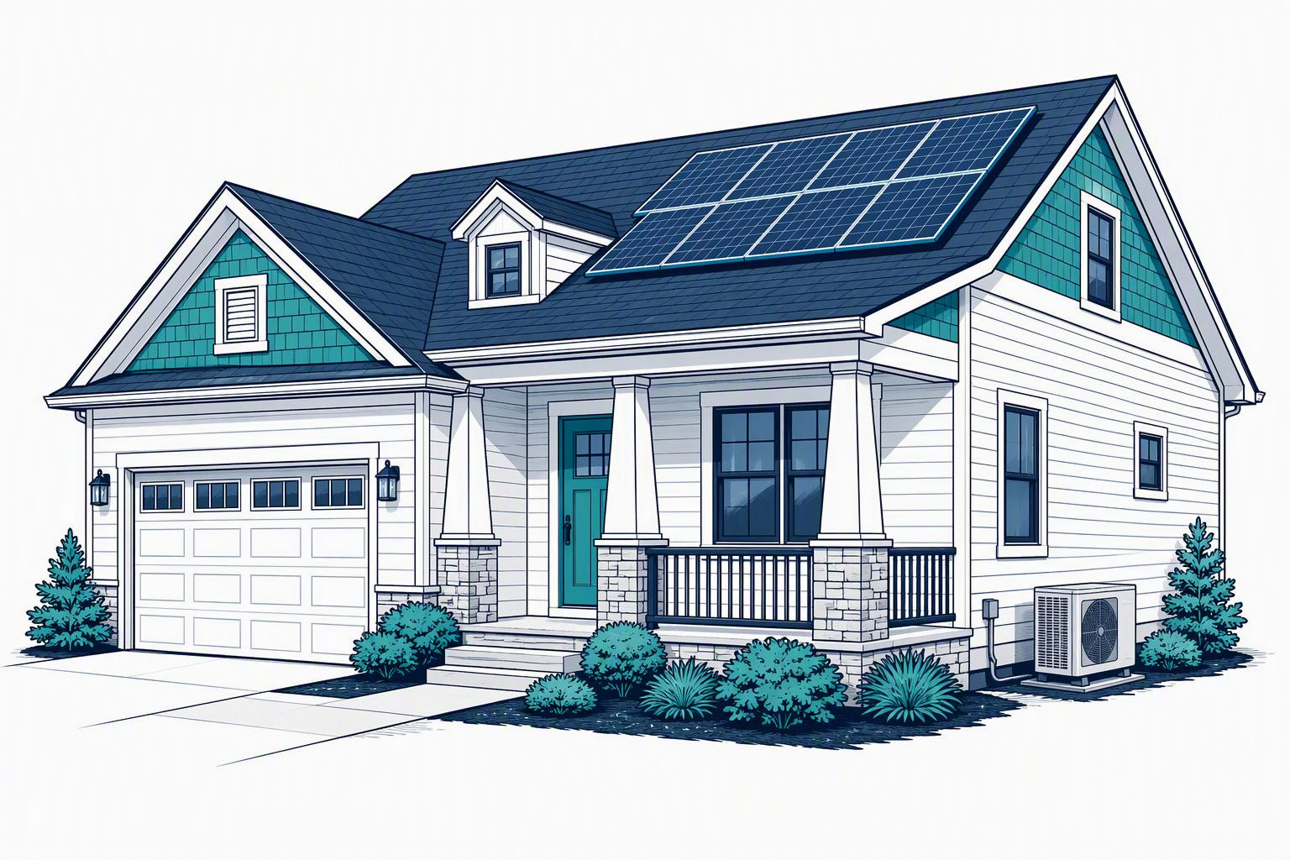
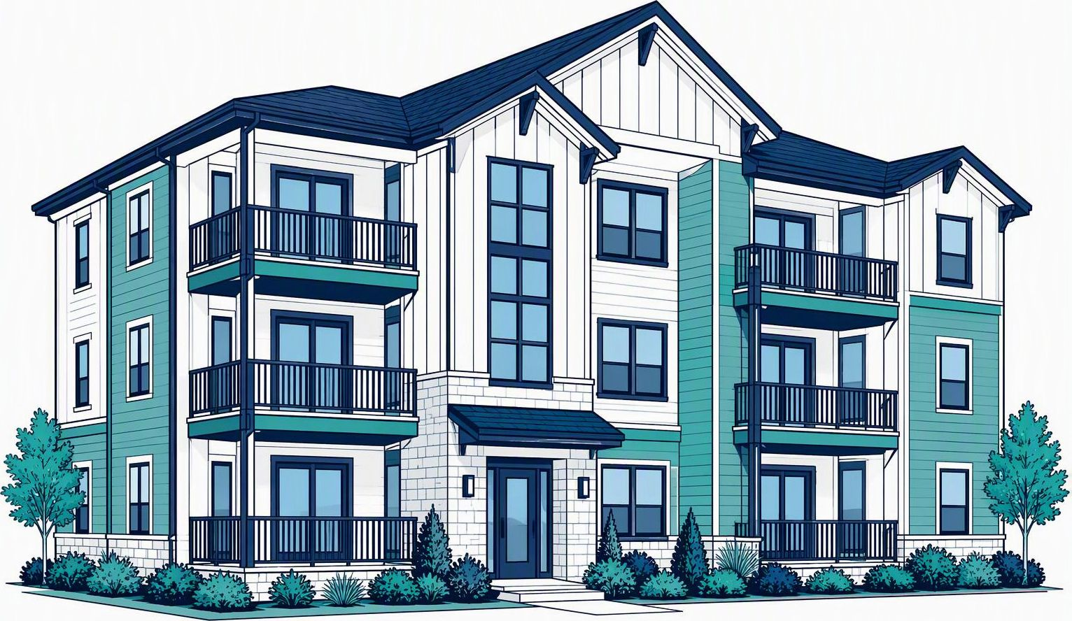
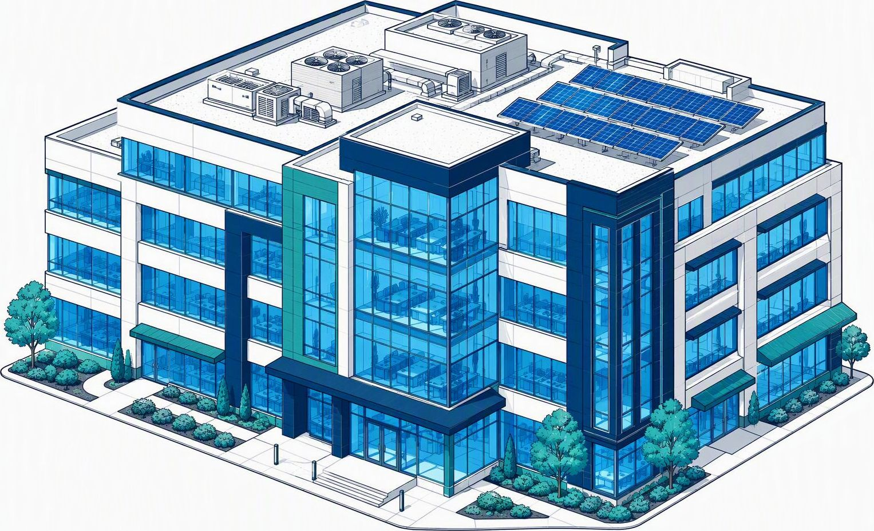
Energy Efficiency Programs
Residential
Ceiling Insulation
HVAC
Solar
Online Marketplace
In-store discounts
A/C Tune-ups*
Weatherization*
*Free service
Multifamily
HVAC
Water heating
Lighting
Envelope
A/C Tune-ups*
Commercial
Central Plants
HVAC
Lighting
Envelope
Solar
Retro-commissioning
Technical assistance*
HVAC Tune-ups*
Notes:
[Sources]
Program content: original user-provided slide, preserved as supplied.
Visuals: AI-generated conceptual illustrations of residential, multifamily and commercial buildings. Not photographs of specific properties.
[/Sources]

Slide 3
Resiliency Sequencing
Resilience
Back-up generator, storage, microgrid
Renewables
Solar, Solar Thermal, Biogas, Waste to Energy
Demand Strategies
Peak Load Control, Demand Response (DR), Automated DR
Energy Efficiency
Central Plants, HVAC, Lighting, Envelope
Infrastructure
IT, BMS, Electrical, Mechanical

